Slide 1


PYTHON
Lecture 37

Slide 2

Today’s Agenda
Dictionary-III
Dictionary Methods
Dictionary Comprehension
Restrictions On Keys

Slide 3
Dictionary Methods
Python provides us following methods to work upon dictionary object:
clear()
copy()
get()
items()
keys()
pop()
update()
values()

Slide 4

The copy( ) Method
This method returns a shallow copy of the dictionary.
Syntax:
dict.copy()
Example:
original = {1:'one', 2:'two'}
new = original.copy()
print('new: ', new)
print('original: ', original)
Output:

Slide 5
copy( ) v/s =
When copy() method is used, a new dictionary is created which is filled with a copy of the data from the original dictionary.
When = operator is used, a new reference to the original dictionary is created.

Slide 6


Guess The Output ?
original = {1:'one', 2:'two'}
new = original.copy()
new.clear()
print('new: ', new)
print('original: ', original)
original = {1:'one', 2:'two'}
new = original
new.clear()
print('new: ', new)
print('original: ', original)
Output: Output:

Slide 7
Using in And not in With Dictionary
We can apply the ‘in’ and ‘not in’ operators on a dictionary to check whether it contains a certain key.
If the key is present then in returns True ,otherwise it returns False.
Similarly , if the key is not present not in returns True , otherwise it returns False

Slide 8
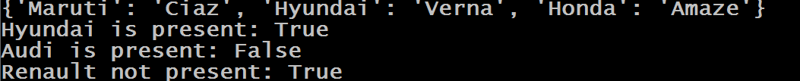
Guess The Output ?
cars = {"Maruti":"Ciaz","Hyundai":"Verna","Honda":"Amaze"}
print(cars)
print("Hyundai is present:","Hyundai" in cars)
print("Audi is present:" ,"Audi" in cars)
print("Renault not present:","Renault" not in cars)
Output:

Slide 9
Dictionary Comprehension
Just like we have list comprehension , we also have dictionary comprehension
Dictionary Comprehension is a mechanism for transforming one dictionary into another dictionary.
During this transformation, items within the original dictionary can be conditionally included in the new dictionary and each item can be transformed as needed.

Slide 10
Syntax For Dictionary Comprehension
Syntax:
dict_variable = { key:value for (key,value) in iterable}
Explanation
Iterable can be any object on which iteration is possible
(key,value) is the tuple which will receive these key-value pairs one at a time
key:value is the expression or key-value pair which will be assigned to new dictionary

Slide 11
Exercise
Write a program to produce a copy of the dictionary cars using dictionary comprehension
cars = {"Maruti":"Ciaz","Hyundai":"Verna","Honda":"Amaze"}
newcars={ k:v for (k,v) in cars.items()}
print(newcars)
Output:

Slide 12
Exercise
Write a program to produce a new dictionary from the given dictionary with the values of each key getting doubled
dict1 = {'a': 1, 'b': 2, 'c': 3, 'd': 4, 'e': 5}
double_dict1 = {k:v*2 for (k,v) in dict1.items()}
print(double_dict1)
Output:

Slide 13
Exercise
Write a program to produce a new dictionary from the given dictionary with the keys of each key getting doubled
dict1 = {'a': 1, 'b': 2, 'c': 3, 'd': 4, 'e': 5}
double_dict1 = {k*2:v for (k,v) in dict1.items()}
print(double_dict1)
Output:

Slide 14
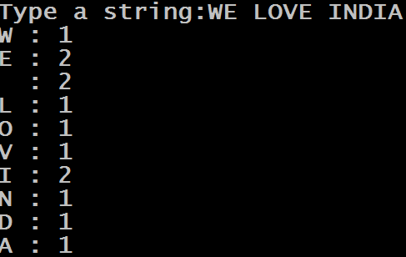
Exercise
Write a program to accept a string from the user and print the frequency count of it’s letters , i.e. how many times each letter is occuring in the string
Output:

Slide 15
Solution
str=input("Type a string:")
mydict={ch:str.count(ch) for ch in str}
for k,v in mydict.items():
print(k,":",v)

Slide 16
Adding Conditions To Dictionary Comprehension
Like list comprehension , dictionary comprehension also allows us to add conditions to make it more powerful.
Syntax:
dict_variable = { key:value for (key,value) in iterable <test_cond>}
As usual , only those key-value pairs will be returned by dictionary comprehension which satisfy the condition

Slide 17
Exercise
Write a program to produce a new dictionary from the given dictionary but with the values that are greater than 2 and store their doubles
dict1 = {'a': 1, 'b': 2, 'c': 3, 'd': 4, 'e': 5}
dict2 = {k:v*2 for (k,v) in dict1.items() if v>2}
print(dict2)
Output:

Slide 18

Exercise
Write a program to produce a new dictionary from the given dictionary but with the double of the values that are greater than 2 as well as multiple of 2
dict1 = {'a': 1, 'b': 2, 'c': 3, 'd': 4, 'e': 5}
dict2 = {k:v*2 for (k,v) in dict1.items() if v>2 if v%2==0}
print(dict2)
Output:

Slide 19
Exercise
Write a program to produce a new dictionary from the given dictionary but the value should be the string “EVEN” for even values and “ODD” for odd values
dict1 = {'a': 1, 'b': 2, 'c': 3, 'd': 4, 'e': 5}
dict2= {k:'even' if v%2==0 else 'odd' for (k,v) in dict1.items()}
print(dict2)
Output:

Slide 20
Restrictions On Dictionary Keys
Almost any type of value can be used as a dictionary key in Python , like integer, float, Boolean etc
Example:
d={65:"A", 3.14:"pi", True:1}
print(d)
Output:

Slide 21
Restrictions On Dictionary Keys
We can even use class names as keys.
Example:
d={int:1, float:2, bool:3}
print(d)
print(d[float])
Output:

Slide 22
Restrictions On Dictionary Keys
Duplicate keys are not allowed. If we assign a value to an already existing dictionary key, it does not add the key a second time, but replaces the existing value:
Example:
d={"MP":"Indore","UP":"Lucknow","RAJ":"Jaipur"}
print(d)
d["MP"]="Bhopal"
print(d)
Output:

Slide 23
Restrictions On Dictionary Keys
If we specify a key a second time during the initial creation of a dictionary, the second occurrence will override the first:
Example:
d={"MP":"Indore","UP":"Lucknow","RAJ":"Jaipur","MP":"Bhopal"}
print(d)
Output:

Slide 24
Restrictions On Dictionary Keys
A dictionary key must be of a type that is immutable. Like integer, float, string and Boolean—can serve as dictionary keys. Even a tuple can also be a dictionary key, because tuples are immutable:
Example:
d = {(1, 1): 'a', (1, 2): 'b', (2, 1): 'c', (2, 2): 'd'}
print(d)
print(d[(1,2)])
Output:

Slide 25
Restrictions On Dictionary Keys
However, neither a list nor another dictionary can serve as a dictionary key, because lists and dictionaries are mutable:
Example:
d = {[1, 1]: 'a', [1, 2]: 'b', [2, 1]: 'c', [2, 2]: 'd'}
print(d)
Output:

Slide 26
Restrictions On Dictionary Values
There are no restrictions on dictionary values.
A dictionary value can be any type of object Python supports, including mutable types like lists and dictionaries, and user-defined objects
There is also no restriction against a particular value appearing in a dictionary multiple times:

Slide 27
Exercise
Write a complete COUNTRY MANAGEMENT APP. Your code should store COUNTRY CODE and COUNTRY NAME as key-value pair in a dictionary and allow perform following operations on the dictionary :
View
Add
Delete
To start the program initialize your dictionary with
the following set of key-value pairs:
IN→India
US→America
AU→Australia
CA→Canada

Slide 28
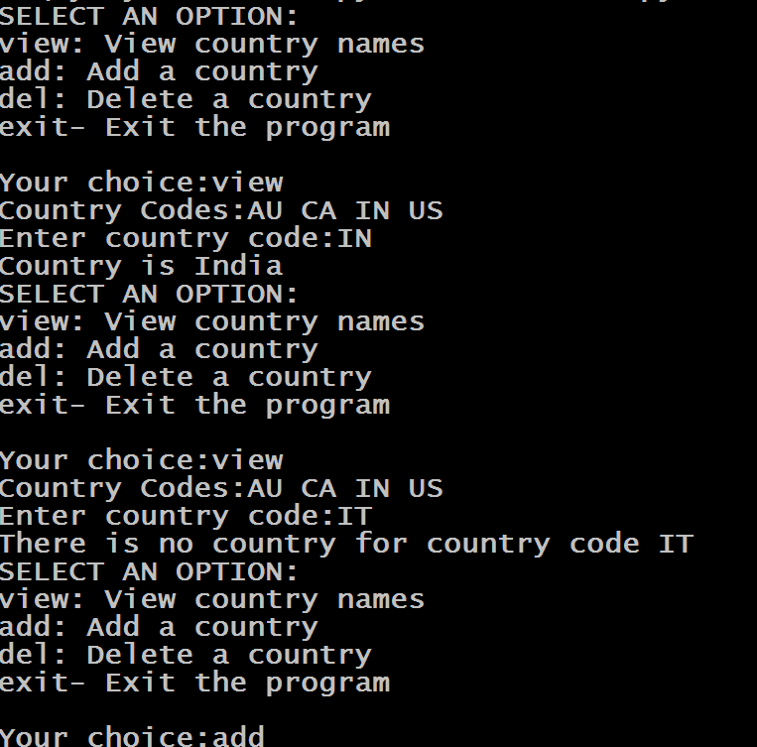
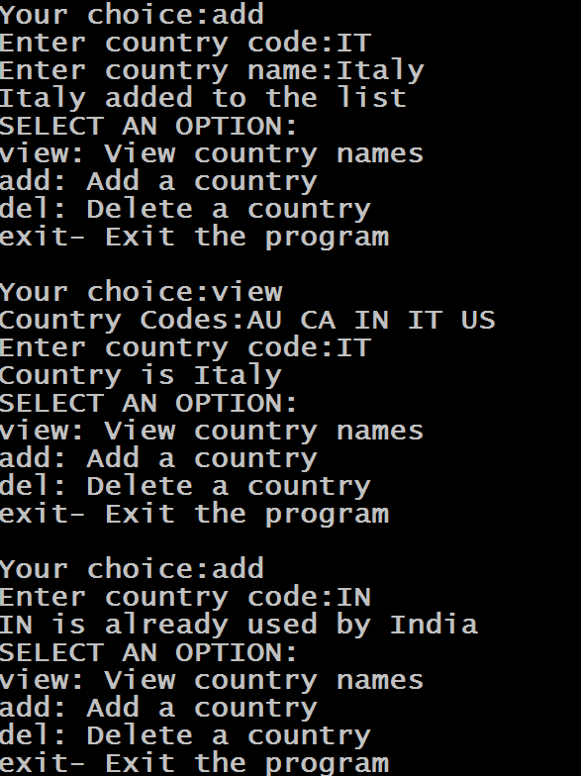
Sample Output

Slide 29
Solution
def show_menu():
print("SELECT AN OPTION:")
print("view: View country names")
print("add: Add a country")
print("del: Delete a country")
print("exit- Exit the program")
print()
def show_codes(countries):
pass

Slide 30
Solution
def view_country(countries):
pass
def add_country(countries):
pass
def del_country(countries):
pass

Slide 31
Solution
countries={"IN":"India","US":"America","AU":"Australia","CA":"Canada"}
while True:
show_menu()
choice=input("Your choice:")
if choice=="view":
view_country(countries)
elif choice=="add":
add_country(countries)
elif choice=="del":
del_country(countries)
elif choice=="exit":
break;
else:
print("Wrong choice ! Try again!")

Slide 32
Exercise
Modify the previous code , so that now you are able to store 3 values for each key . These are COUNTRY NAME , CAPITAL CITY and POPULATION. Provide same options to the user and start with the following data
IN→India , Delhi,1320000000
US→America,Washington,320000000
AU→Australia,Canberra,24000000
CA→Canada,Ottawa,940000

Slide 33
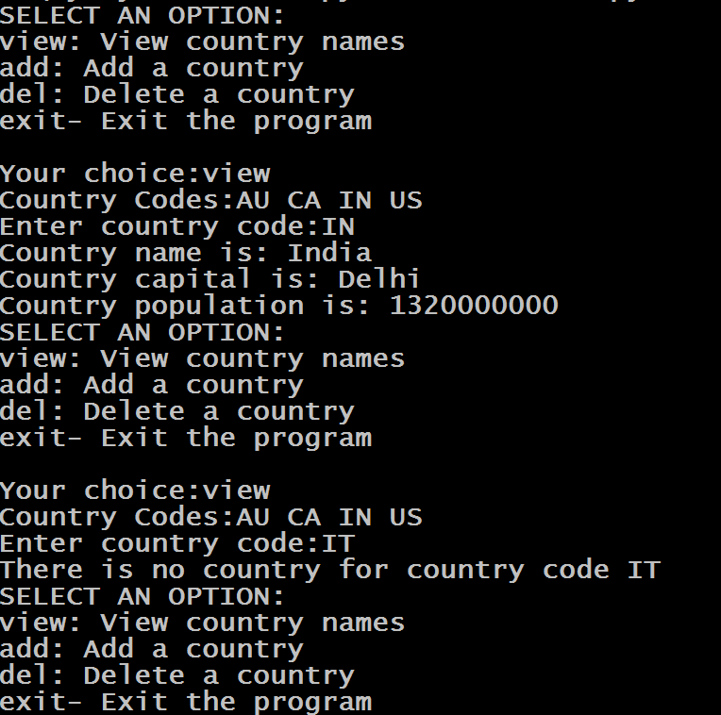
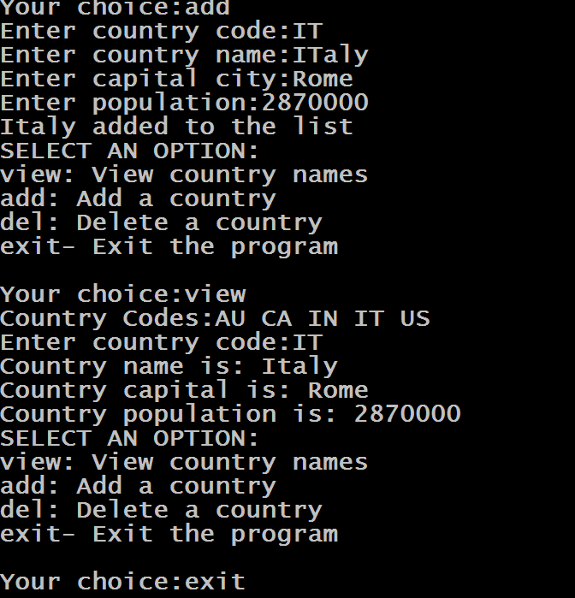
Sample Output

